Slide 1





Sustainability
at
Fairleigh Dickinson University
Shunqi Zheng(Edward)

Slide 2


1
Background
2
purpose
Content
3
Proposal
4
Reference

Slide 3

Background
01

Slide 4
Background
In recent years, Fairleigh Dickinson University has seen a rising interest among university constituents, students, staff, and faculty alike, to embrace sustainability at the University.
As a result, FDU is seeking to develop Sustainability Initiatives at its two New Jersey campuses that may be included in its Strategic Plan for 2021-2025.

Slide 5

Letter of transmittal
Strategic Plan Committee for Sustainability
The Office of the University Provost
Fairleigh Dickson University
1000 River Road, H-DHI-03
Teaneck, NJ 07666

Slide 6
Purpose
02

Slide 7
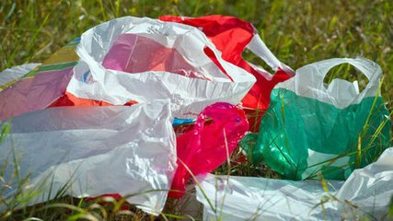
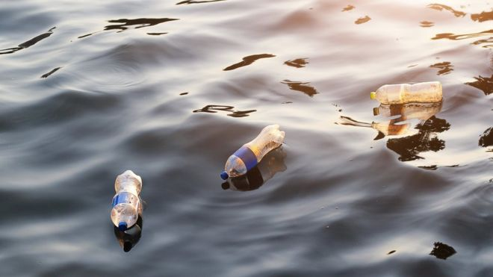
Purpose
Plastic bags floating in the air Plastic bottles floating on the sea
Even plastic bags we use in our everyday life take anywhere from 10 to 1,000 years to decompose and plastic bottles can take 450 years or more

Slide 8
Purpose
First goal is to create a more sustainable and
Cleaner environment at Fairleigh Dickinson University
The second goal is to encourage students to
Use reverse vending machines
Pay the cost to the meal plan for students

Slide 9
Proposal
03

Slide 10
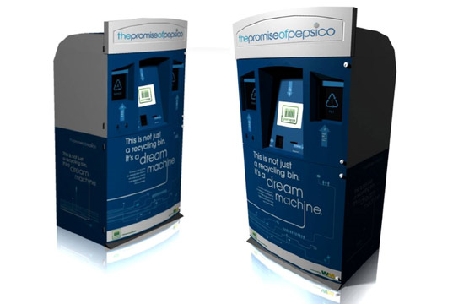
Proposal
EAEB
an idea: a new equipment
Economic And Environmental Box” (EAEB)
convenient and good-looking
Like an ATM, Huh?

Slide 11
“EAEB” Function
get snacks and drinks (same as vending machine)
accept canned and other non-perishable items
Give certain money
supports login in mobile

Slide 12
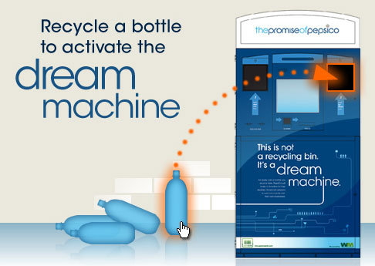
How to use “EAEB”?
instructions along with images
Login in as a user in an app, or use it as a guest
Put acceptable stuff in its container

Slide 13
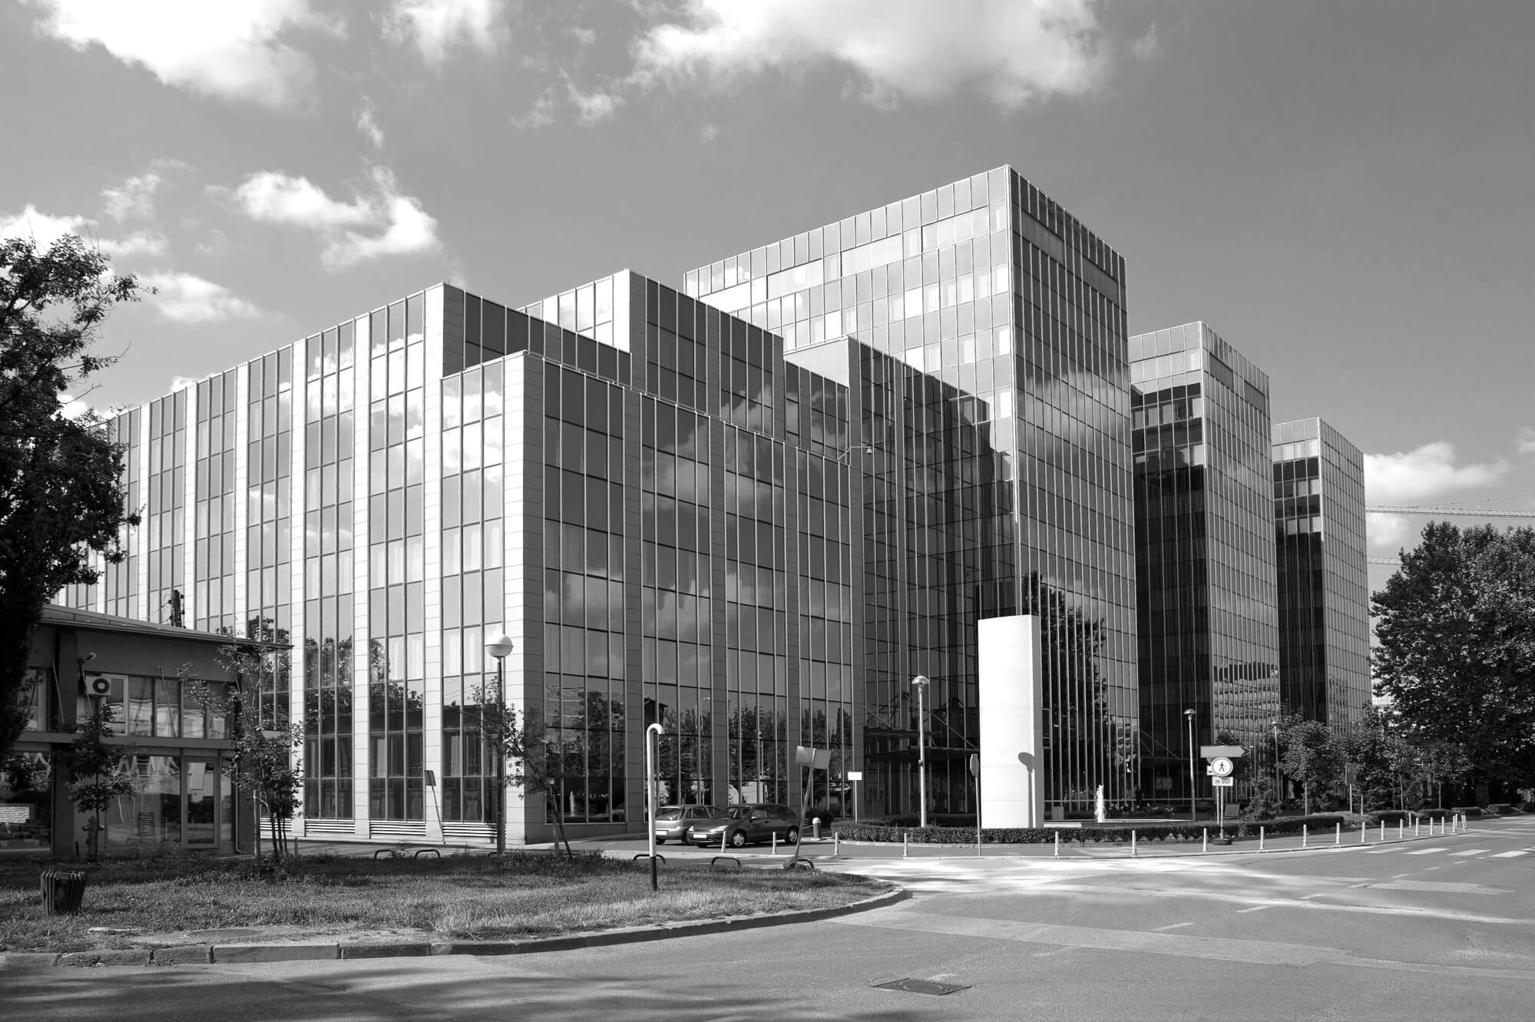


A big program
03
01
02
Result and influence
Why it should be introduced?
How to start?
03
01
02

Slide 14
Why it should be introduced?
EAEB
a lot of vending machines at the FDU
Many students use it
a good place for us to build up a recycling machine

Slide 15


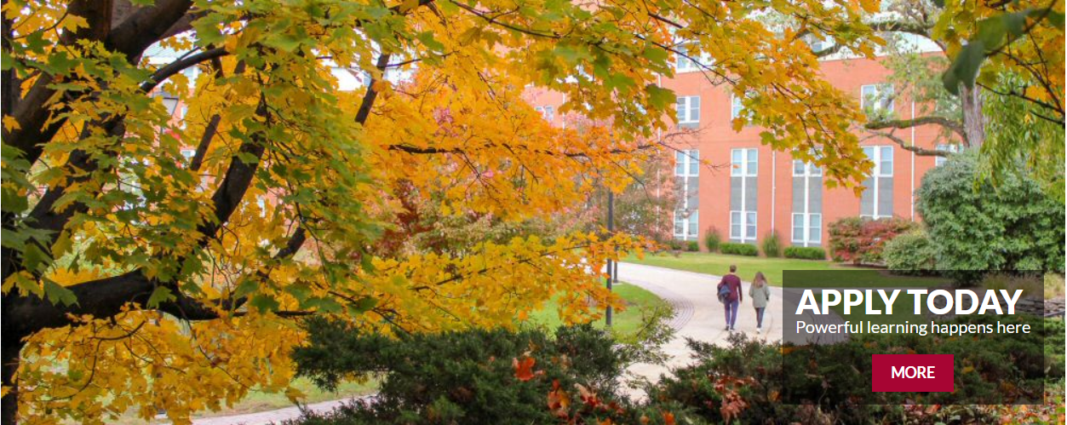
How to start?
encourage and get them into an event
making posts, sending emails
allow them to know what this machine is
have someone who are the biggest contributors get rewards

Slide 16
Result and influence
awareness
raises people the awareness of the environment
engagement
potentially gets more people to engage
follow
other campuses would follow
advocate
advocate the original and environmental strategy
better
let campus more renewable and amazing.

Slide 17

Timeline
2019
2019
2020
2020
2022

Slide 18
Reference
04

Slide 19
Reference
Campus Recycling Six Lessons from a Gas Station, Adam, 2016 Retrieved from: https://www.aashe.org/campus-recycling-six-lessons-gas-station/
Greener Package official web page, PepsiCo unveils reverse-vending ‘Dream Machine’ to encourage recycling, Retrieved from: https://www.greenerpackage.com/recycling/video_pepsico_unveils_reverse-vending_%E2%80%98dream_machine%E2%80%99_encourage_recycling
Environmental Science organization official web page, What Is Sustainability and Why Is It Important, Retrieved from: https://www.earthsfriends.com/why-recycling-important/
Sustainable Business, Decomposition of Waste in Landfills, Retrieved from: https://www.thebalancesmb.com/how-long-does-it-take-garbage-to-decompose-2878033
Youtube Video web page, Retrieved from: https://www.youtube.com/watch?v=znwFOCFd0XM

Slide 20




Thanks for listening!

